Slide 1
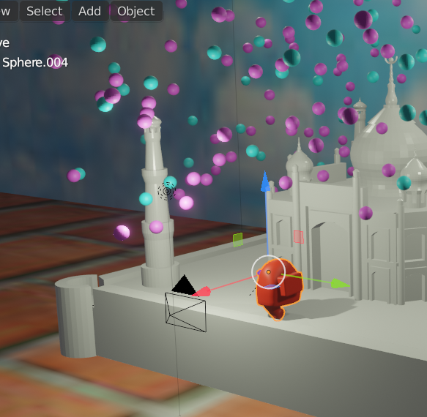
Among Us at Taj Mahal, and surprise colourful snowfall
Topic- Individual Project
Contributor- Sweta Das
Student ID: 18080395d

Slide 2
Idea and theme-
One of the characters from the game ‘Among Us’ arrived at Taj Mahal for a discovery task.
While he runs around, a surprise colourful snowfall occurs.
As he runs, the camera follows his movements around the monument.
In the very short animation, with the character we navigate little bit around Taj Mahal.

Slide 3
Note: Some pattern in the slides-
Wherever arrows are not places along with the pictures, that means the pictures are just independent screenshots, do not represent any sequence/ steps.
Wherever arrows are placed, it means that the pictures represent steps/sequence one after the other.

Slide 4
Taj Mahal model Construction

Slide 5
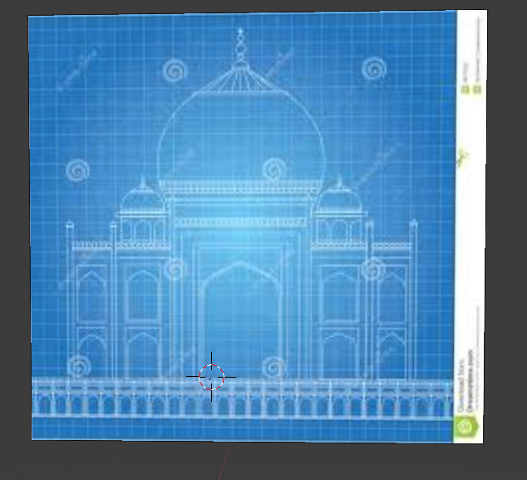
Drag and drop the blueprint image of Taj Mahal into blender

Slide 6
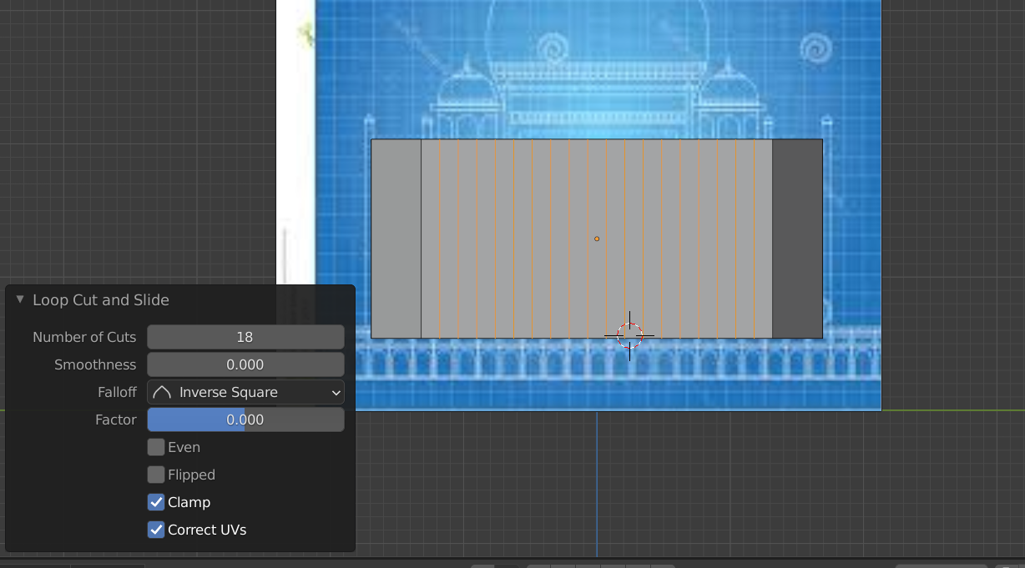
Insert a cube, the go to edit mode->select the leftmost and rightmost edges of the frontmost face of the cube.
Ctrl+B to bevel.
Make loop cuts in edit mode by selectin the loop cut option or Ctrl+R

Slide 7
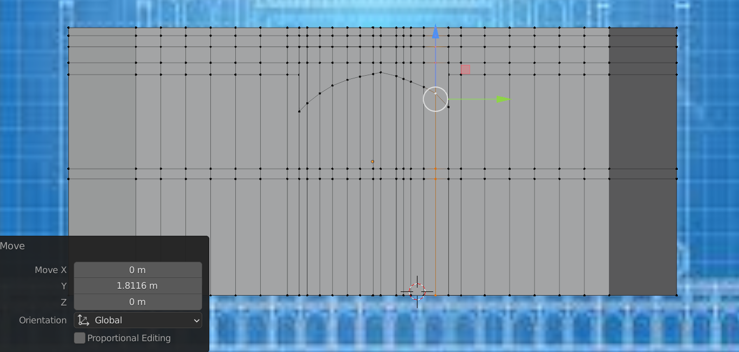
Show the vertices by pressing ‘1’ in edit mode. Select the vertices and pull them down one by one to make the shape of the curved door.

Slide 8
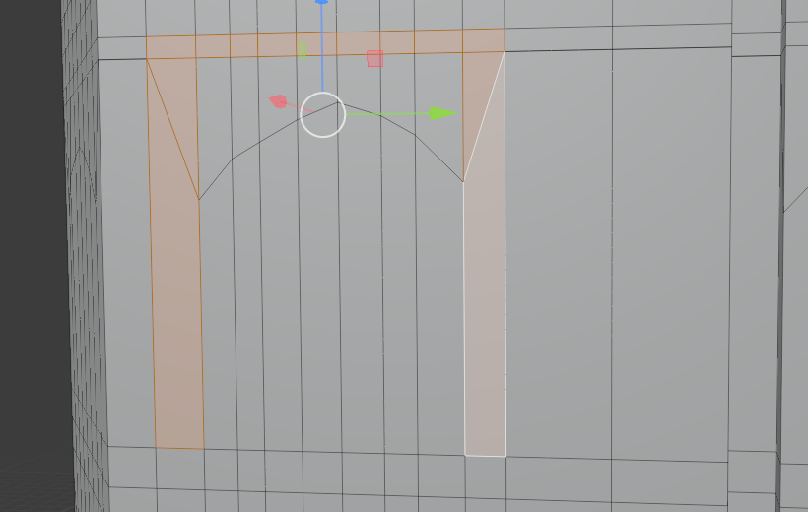
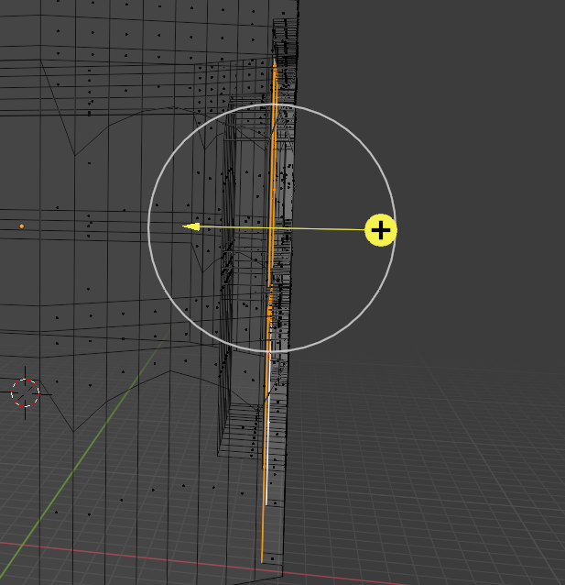
Select the faces around the door outline by Shift+select.
Select extrusion by face and extrude inwards.

Slide 9
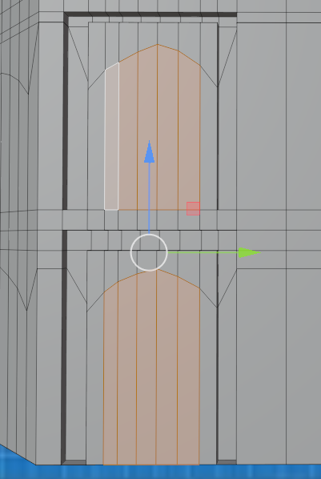
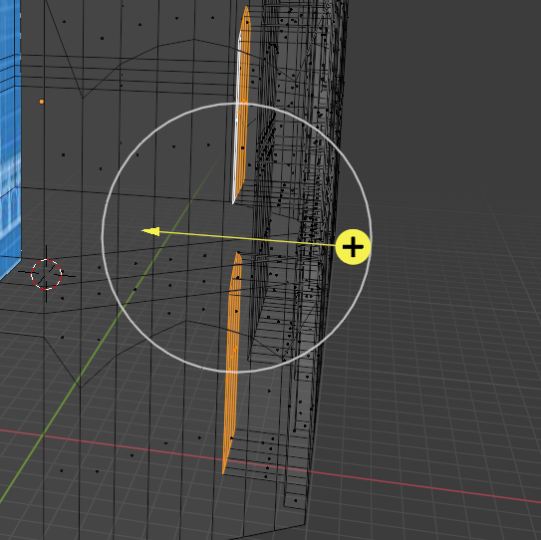
Do extrusion with faces of the door too in similar manner.

Slide 10
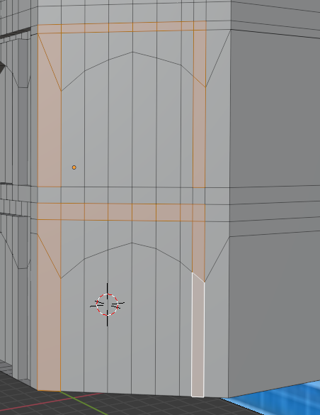
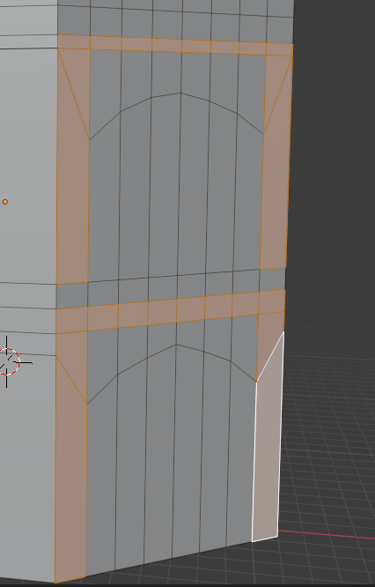
Continue the same steps of making the door outline to extrusion of faces in the 2 side faces beside the front face.

Slide 11
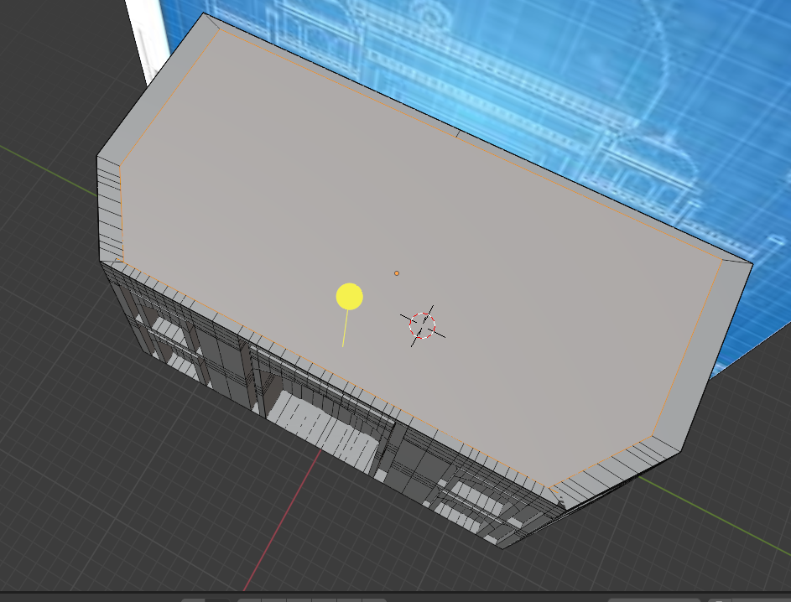
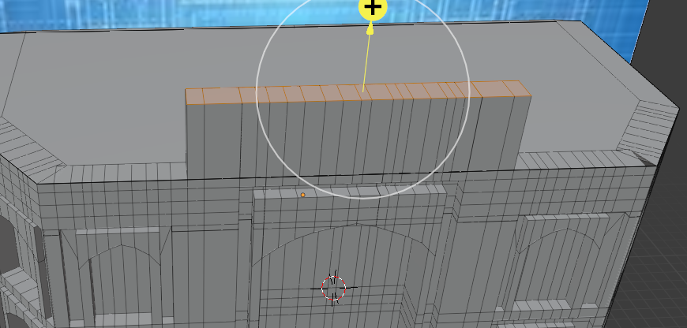
Select some of the faces on top of structure and extrude it upwards.

Slide 12
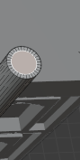
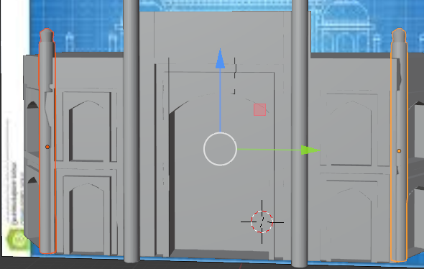
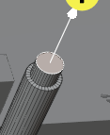
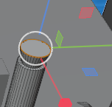
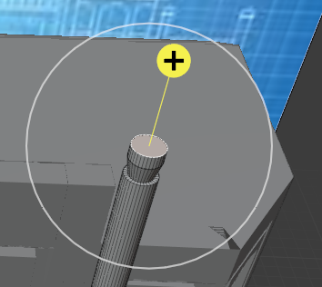
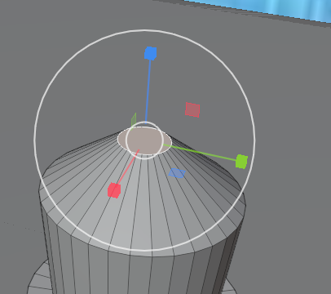
Insert a cylinder to make a pillars as shown on left.
In edit mode, select the top face and Inset the face inwards. Then extrude the face up.
Scale the face outwards.
Again extrude the face upwards and finally scale the face inwards.

Slide 13
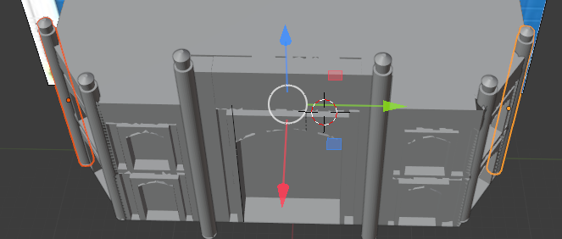
Shift+D to duplicate the pillars and locate in the viewport accordingly.

Slide 14
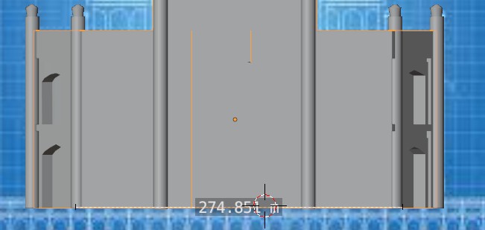
Take the measurement using the measurement tool in the object mode to keep note while duplicating.

Slide 15
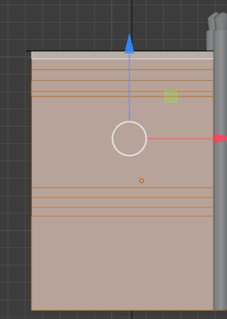
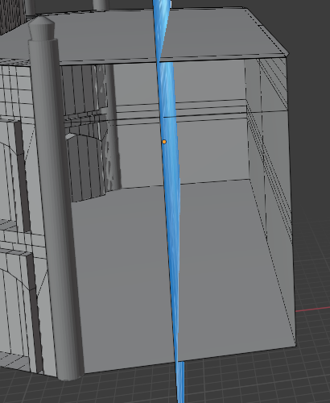
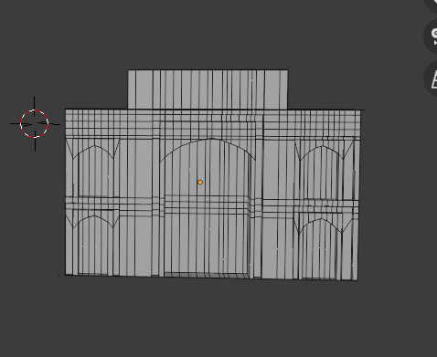
Select the cube part of the model constructed till now. Delete the side faces

Slide 16
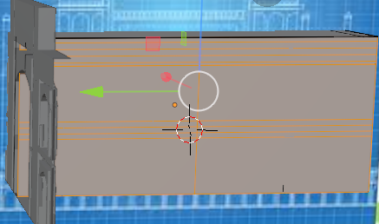
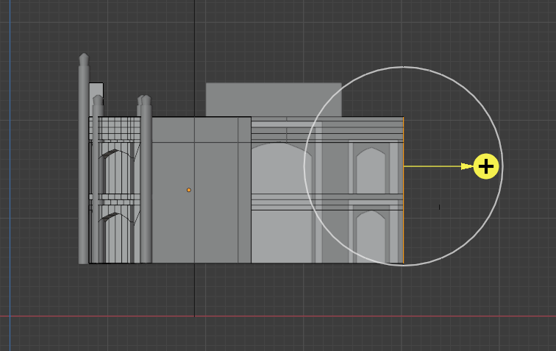
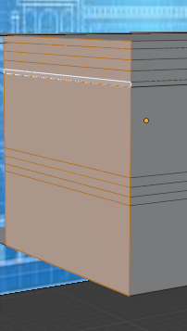
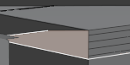
Shift+D to duplicate the cube part of the model.
Translate it farther. Delete the side and behind faces.
Place the edited piece as the sideward door on left of the model.

Slide 17
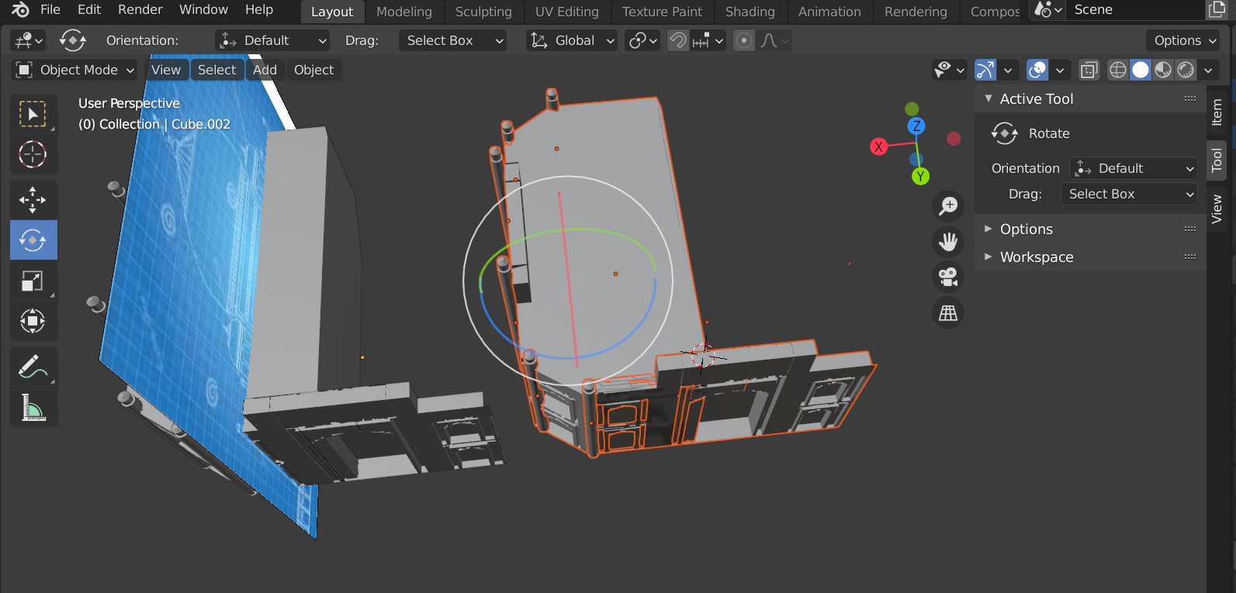
Shift+D to duplicate everything except the image.
Then rotate it to make a base construction of the monument.

Slide 18
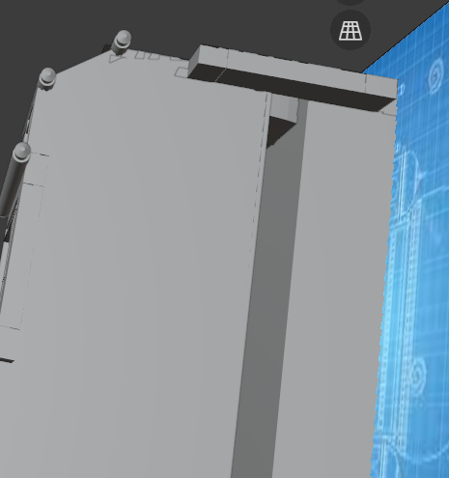
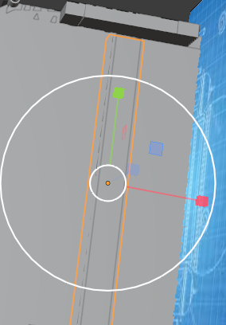
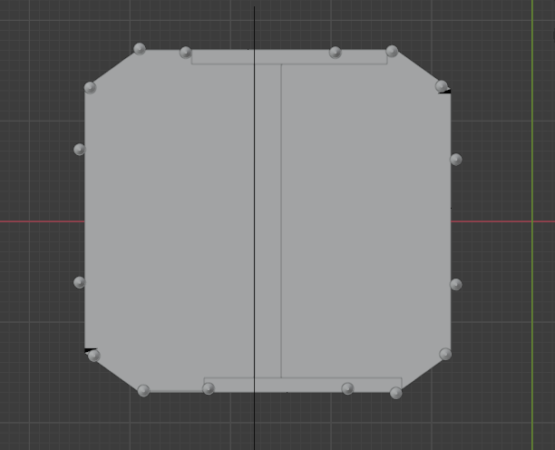
There is a space on top after placing everything as per the correct positions. Therefore either insert a plane or a cube to cover the space.

Slide 19
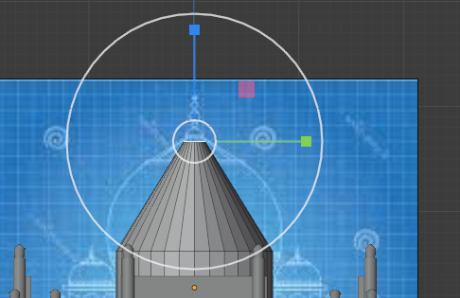
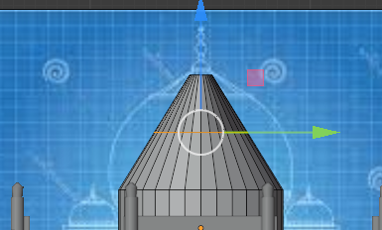
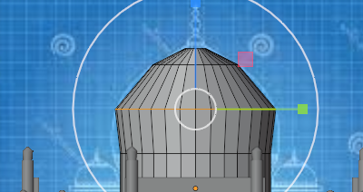
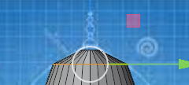
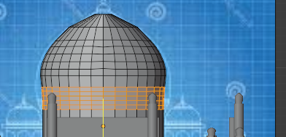
To make the dome, place a cylinder on the top surface which was recently covered up in the last slide.
Scale it down, go to edit mode. Select the top face. Extrude it by face. Then scale the face inwards.
Insert a loop cut.
Scale out the recently made edge by the loop cut.
Insert another loop cut below the recently scaled edge and do the same step as above.
Press Ctrl+B to bevel and scroll up the cursor to increase cut, to make the dome shape smoother.

Slide 20
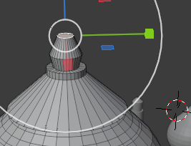
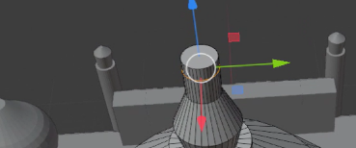
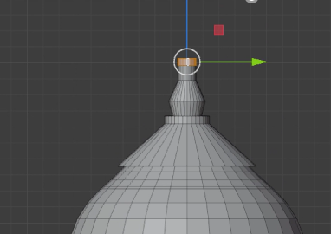
To make a pillar on top of the main dome-
Insert a small cylinder.
In edit mode extrude up. Then scale the face outwards.
Extrude up again and scale the face inwards. Then make a loop cut and then scale out the faces enclosed in the upper part of loop.

Slide 21
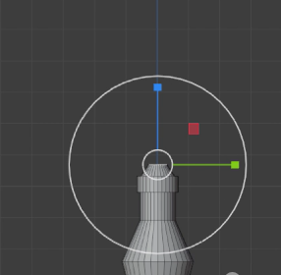
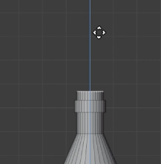
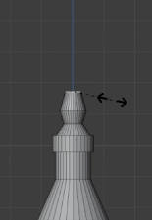
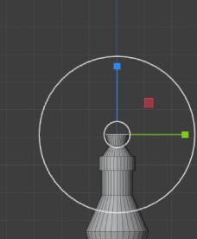
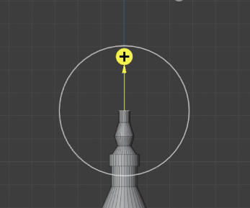
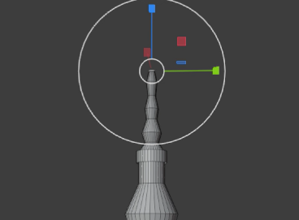
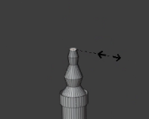
Inset the face inwards then extrude that upwards.
Scale the face inwards.
Extrude the face upwards then scale face outwards. Extrude the latest face and scale inwards.
Repeat this 3 times to get 3 units of bent diamond like structures in the uppermost pillar.

Slide 22
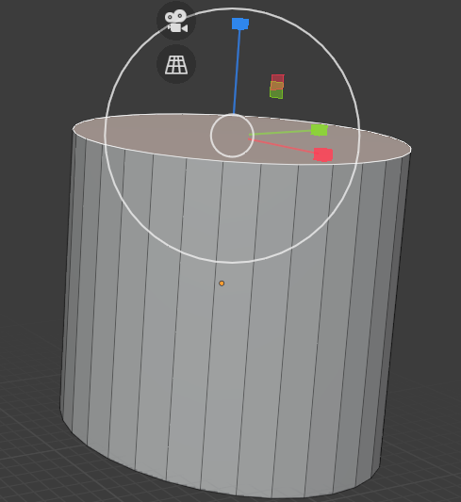
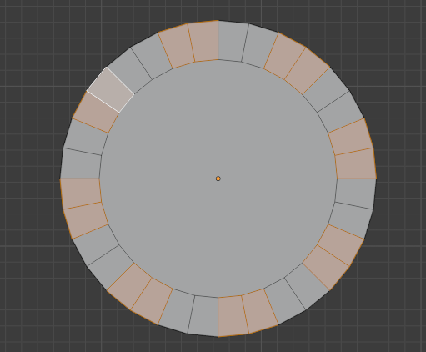
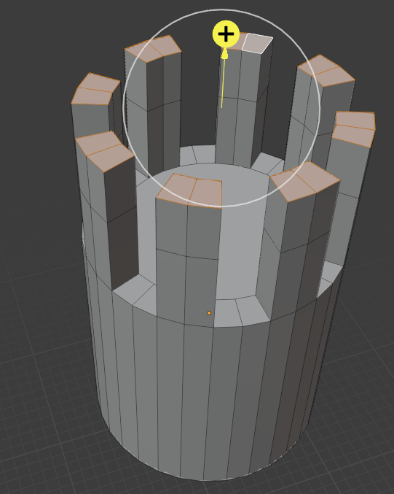
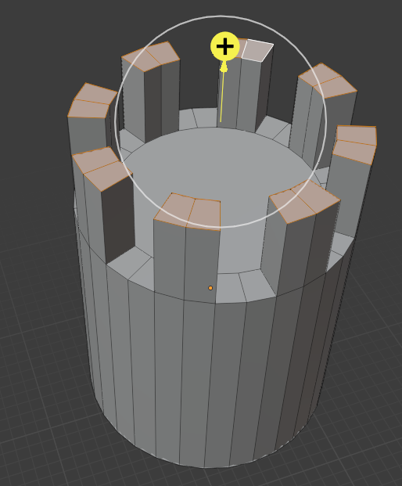


Making the other inner pillars-
Add a cylinder and bevel its face inwards by Ctrl+B.
Select each of the two faces on the outer edges by leaving a gap of two faces in between.
Extrude the selected faces upwards.
Extrude again.
Scale put the faces in current selection.
Copy paste the tomb by Shift+D structure, excluding the crescent and the sphere. Scale the clone smaller accordingly. Place it on top of the recent cylindrical structure which we modelled now.

Slide 23


Making the other outer pillars-
Add a cylinder.
The steps are very similar as in slide 20 (pillar on top of the dome in the centre).
Inset the upper face inwards->extrude inner face upwards->extrude the face upwards again->Scale out the face->Extrude the face upwards.
Inset the face inwards->extrude the inner face upwards->scale the face inwards->extrude the face upwards->scale it outwards->extrude the face upwards.
Repeat the previous step one more time.
Duplicate the inner pillar constructed in the previous slide and scale it smaller accordingly to place it on top of the stand of the outer pillar made until this slide.

Slide 24




Select the circular edges on the pillar, bevel by Ctrl+B, scroll up the middle cursor button to increase number of cuts.
It helps to increase smoothness.

Slide 25









To make this crescent and sphere on top of the pillar-
Insert a cylinder. Inset the face in edit mode. Delete the inner face.
Select the half of the upper faces and delete them.
Select the remaining upper faces and extrude downwards by face.
Edge select the inner and outer edge below and press F to fill in the gap.
Close the open squared faces by selecting the edges and pressing F, as done above.
Extrude the inner faces outwards.
Make one loop cut.
Remove the unnecessary faces by selecting by face and pressing delete->Faces.

Slide 26


Insert 4 cylinders around the structure formed.
Place a cube as a platform.

Slide 27


On the cylinders, inset the faces and cut the other half side’s faces.
Shown are the selected faces on the other half side which are to be extruded later.

Slide 28


Make the extrusions of cylinder’s faces on the half side as shown in previous slide and the outermost faces in the loop cuts made.

Slide 29

Some unwanted edges and cuts which are extra, might appear on the finished model.
Therefore, before proceeding, make sure to delete them.

Slide 30




For the emitter, add a circle.
Go to edit mode after selecting the circle. Then press F to fill the face.
Insert two Particle entities on the Particle properties option.
Insert two more spheres of different colours.
Inside each of the particle system, go to Render option, set the option ‘Render as’ Object, select one sphere. Here, below is an example where blue sphere is selected.

Slide 31

The spheres above acted as instances of particle emissions.
We don’t want them to cast any shadow, therefore under Material properties under Settings option, set ‘Blend Mode’ to Opaque, and ‘Shadow Mode’ to None.

Slide 32

Until now we have achieved this.
Select all the objects of the Taj Mahal model->Right click-> Shade smooth.
Place the circle above the model of Taj Mahal so that particles fall over the model when emitted.

Slide 33

Add two planes (I deleted the right plane later).
Add a sky texture for the vertical plane.
Add a brick texture to the horizontal plane.

Slide 34




Steps to add texture-
Select the material in ‘Object mode’ where texture needs to be added. Under Material properties click on ‘New’ to add a new material which will be our texture material.
Click on yellow dot in the ‘Base colour’ option.
Click on ‘Image texture’.
Click on ‘Open’ and select an image to add as your texture.

Slide 35
Among Us character

Slide 36


Insert a sphere.
Select the top faces in edit mode and scale them upwards.

Slide 37


Select the proportional editing option on the top bar besides the ‘Global’ navigation option.
Select the bottom faces and scale lesser in vertical direction.
Select the top faces again and scale inwards.

Slide 38



Add a sphere and scale it narrow to act as nose for the character.
Remove the faces on the other half side.
Then place it well entering little inside the main body of the character.
Right click on the nose and select ‘Shade smooth’.

Slide 39


Make the backside flatter by selecting the lower back faces in edit mode and scaling inwards.
Add a cube as backpack of the character.

Slide 40

Add a cylinder as leg of character.
In edit mode bevel up the lowest face by Ctrl + B and scroll up mouse wheel to add more edges.
Duplicate the leg and translate it as another leg of the character.
Press Ctrl+J to treat all the part of the character as a single entity.

Slide 41



Insert an armature. Place it inside the body of tth character.
In edit mode, right click and select subdivide. Change the number of cuts to 2.
Then we see 3 bones visible.

Slide 42




Insert more bones in the edit mode. This time, to construct the thigh and leg bone, insert one bone and tilt it as shown in first figure.
Insert a bone in leg. Right click->subdivide. We see there are 2 bones now for leg.
Do the same for other leg too.

Slide 43





Tilt the uppermost bone of the body little towards the backside.
Copy that bone and place it inside the nose of the character.
Copy the second bone from the top and place it inside the backpack.
Go into the ‘Pose mode’ by pressing Ctrl+Tab to test movement of the character.
Select the character made and after that armature in the collection panel, make armature the parent of character by pressing Ctrl+P->make parent.

Slide 44



In the Pose mode, rotate the leg bones of one leg frontwards, backwards for the other leg.
Insert a keyframe in the timeline.
Copy paste the keyframe at each 30th frame until the 100th frame is reached.
Below is the final timeline shown until this step.

Slide 45


Select the faces associated with the nose of the character in edit mode.
Add a material to the character which is purple in colour. Click on the purple material and click on assign.

Slide 46


I animated camera along with the among us character walking. Below are timelines of camera and the character respectively.

Slide 47

For the model of Taj Mahal, under Material properties, under Settings options, set Blend mode to Opaque and Shadow mode to None.

Slide 48


Export the video by going to Output properties.
Under the frame rate option set the fps to 24.
Set frame start to 1, end to 100.
Under Output option set the output folder of choice.
Set File from option to ‘AVI JPEG’.
The video is for 4 seconds.

Slide 49

Make sure to pack the textures into the .blend file.
Steps: File->External Data-> Pack All into .blend

Slide 50
Precautions and Tips
Follow the previous slide to make sure that the textures in the file are not lost when it is being downloaded after being sent or uploaded somewhere.
If taking screenshots while working on blender seems to be hindering your work, take a video while working on blender. Pause the video whenever screenshot needs to be taken.
Save multiple versions of the work after achieving sub steps like, one after making Taj Mahal model, one after making Among Us model, one after making half of the animation. Or, two copies for each sub step. I have made 9 versions.
If Blender is hanging in between, then Shut down or set your device to Sleep mode for a while (15 minutes) one in each 2-3 hours.

Slide 51
References-
Lecture + Lab notes of COMP4422.
For Taj Mahal model- 3D Taj Mahal İn Blender 2 90 Timelapse – YouTube
For Particle system simulation- Blender Particles Tutorial - Blender 2.9 Beginners Tutorial – YouTube
For Among Us character building- Make Your Own 3D "Among Us" Character Rig in Blender 2.9 – YouTube
For Among Us character rigging and animation- Among Us Game Character - Blender 2.9 - YouTube

Slide 52
Thank You

